Slide 1

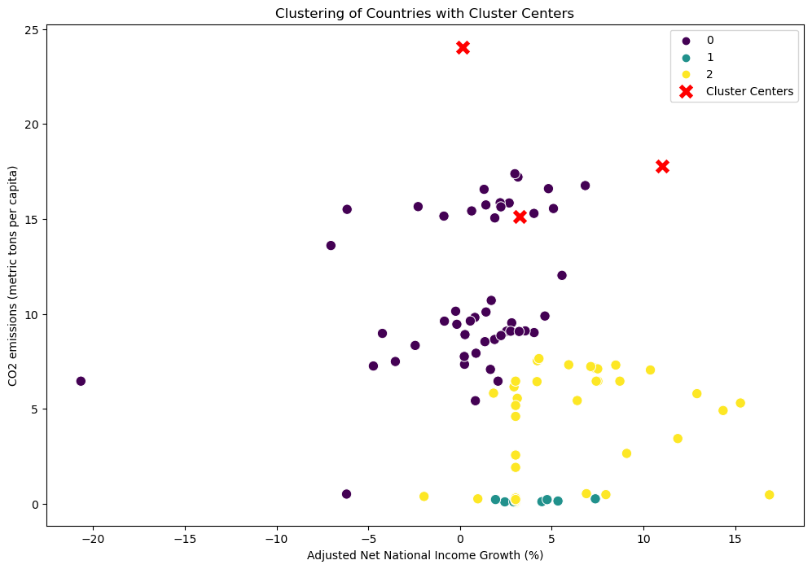
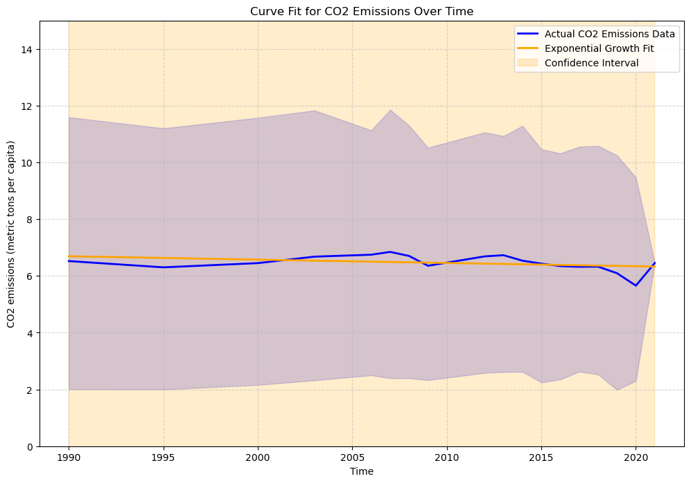
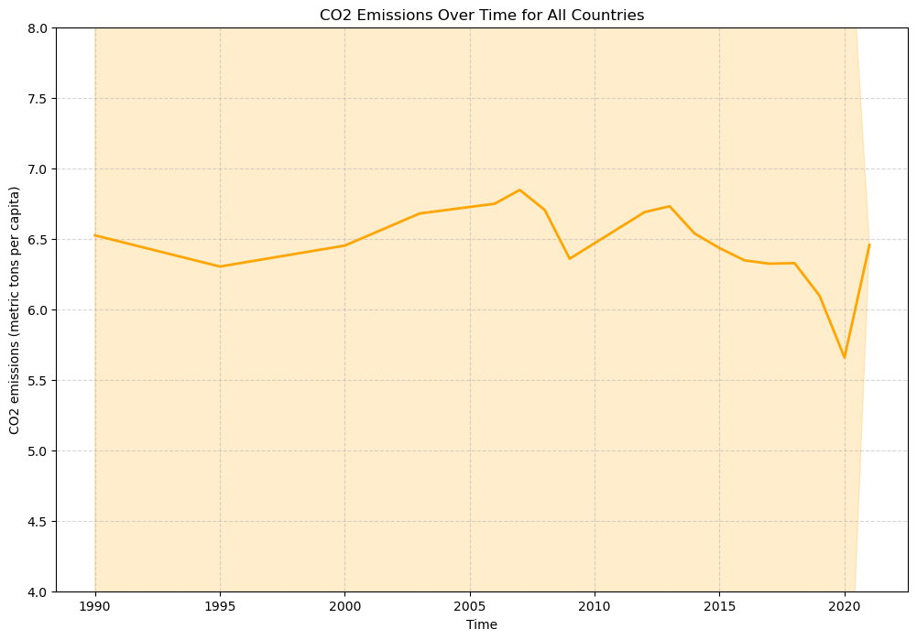
"Decoding the Environmental-Economic Nexus: Analyzing CO2 Emissions, Growth Dynamics, and Clustering Trends"
Name : Subash Reddy Padigela
Student ID : 22088785
ABSTRACT
This comprehensive analysis delves into the intricate relationship between economic indicators, CO2 emissions, and clustering patterns among countries. Utilizing advanced data analytics, including KMeans clustering and exponential growth modeling, we unravel key insights into the dynamics of environmental sustainability and economic development.
INTRODUCTION
This analysis delves into the interplay between economic growth and CO2 emissions, employing advanced techniques like KMeans clustering and exponential growth modeling. By dissecting the relationship between adjusted net national income growth and CO2 emissions, the study aims to provide actionable insights for sustainable development and informed policy decisions. Unveiling hidden patterns, this analysis contributes to the global dialogue on achieving a balance between economic progress and environmental responsibility.
1.Data Cleaning and Pre-processing
Raw data is sourced from a CSV file and cleaned by replacing non-numeric values with NaN.
Imputation using the mean is employed to address missing values.
Relevant columns, including CO2 emissions and Adjusted Net National Income growth, are selected for analysis.
2. Clustering Analysis:
a. KMeans Clustering:
Clusters: Countries are grouped into clusters based on normalized CO2 emissions and economic indicators.
Silhouette Score: A silhouette score of 0.3388 indicates suggests a moderate level of clustering quality in the analyzed data.
b. Cluster Visualization:
The scatter plot visually represents clusters based on Adjusted Net National Income Growth and CO2 emissions.
Cluster centers are marked in red, providing a clear distinction between groups.
3. Exponential Growth Modeling:
a. Fitted Exponential Growth Model:
An exponential growth model is fitted to the time series data of CO2 emissions.
The model parameters (amplitude and growth rate) are optimized using lmfit.
b. Curve Fit Visualization:
The fitted curve, actual CO2 emissions data, and confidence interval are plotted.
The model captures the underlying growth pattern, allowing for trend interpretation.
4. Prediction and Future Insights:
Future values of CO2 emissions are predicted for 2024, 2027, and 2030.
These predictions offer insights into potential trends, aiding in long-term planning and environmental impact assessment.
5. CO2 Emissions Over Time:
A line plot illustrates CO2 emissions over time for all countries.
This provides a holistic view of trends and variations in emissions.
Cluster Analysis:
The clustering analysis reveals distinct groups of countries based on net national income growth and CO2 emissions. Policymakers can use this information to tailor environmental and economic policies to specific clusters, addressing the unique challenges and opportunities within each group.
Exponential Growth Model:
The curve fitting analysis suggests an exponential growth pattern in CO2 emissions over time. This insight is valuable for forecasting future emissions trends, assisting in the development of targeted strategies for carbon reduction and sustainable practices.
CO2 Emissions Over Time:
The analysis of CO2 emissions over time provides a temporal perspective, helping stakeholders understand the dynamics of emissions changes. Identifying peaks or declines in emissions can guide efforts to implement effective environmental policies.
Conclusion:
In summary, the analysis revealed distinct clusters of countries based on net national income growth and CO2 emissions. The exponential growth trend in emissions highlights the urgency of addressing environmental implications. The temporal dynamics underscore the importance of historical trends. The moderate silhouette score indicates cohesive clusters with some overlap, suggesting additional influencing factors. These findings provide valuable insights for tailored policy interventions, emphasizing the need for sustainable development strategies that balance economic growth and environmental preservation.
Data source link : https://databank.worldbank.org/source/world-development-indicators#advancedDownloadOptions
GitHub link : https://github.com/subashreddy222/ADS1-Assignment-3.git

